Slide 1
Multimodal Information Processing: Some recent NLP applications
Dr. Sriparna Saha
Associate Professor
Department of Computer Science and Engineering
Indian Institute of Technology Patna
Bihar, India
H5-index:38, total citations: 7608 (as per Google scholar)
Email: sriparna.saha@gmail.com/sriparna@iitp.ac.in
Webpage: www.iitp.ac.in/~sriparna

Slide 2
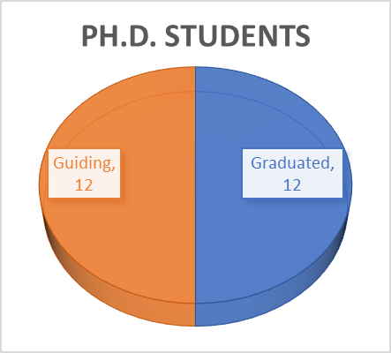
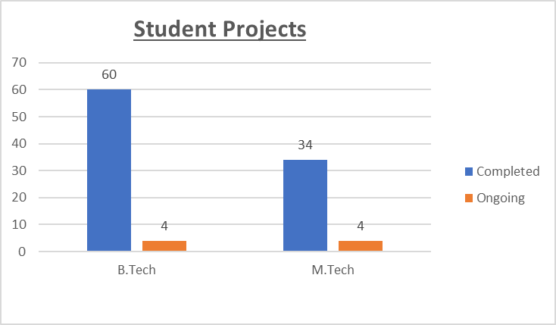
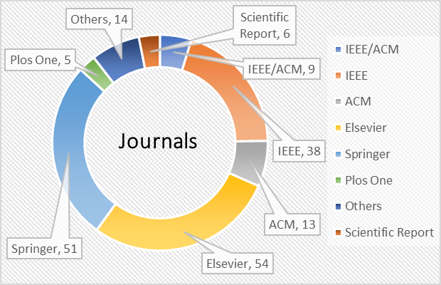
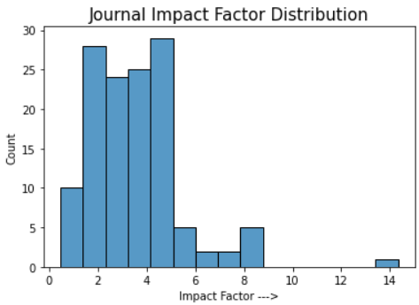
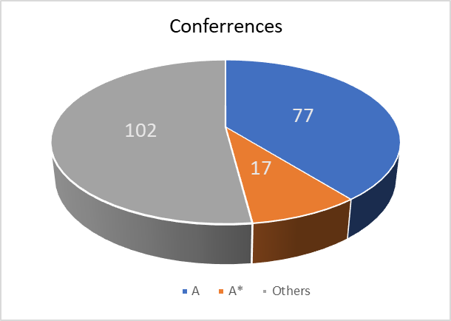
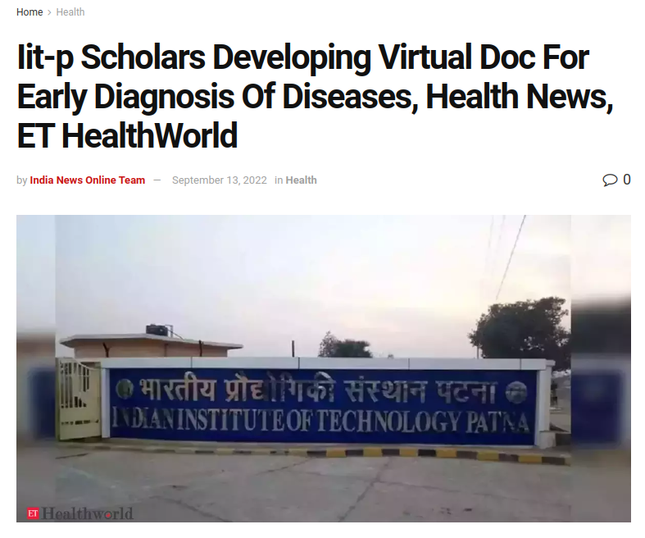
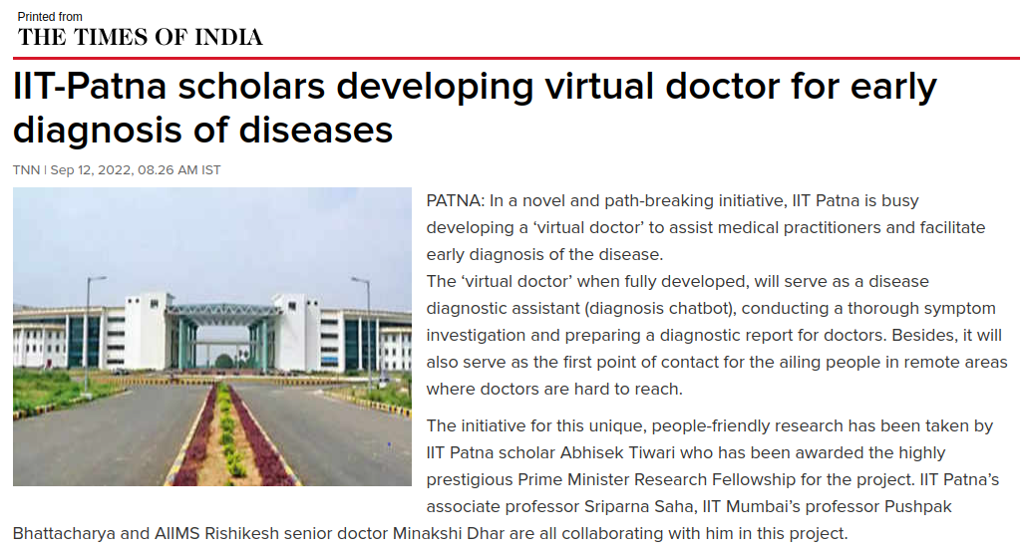
Research
Research Areas: Natural Language Processing, Deep Learning, Machine Learning, Pattern Recognition
Multimodal Information Processing
Complaint Mining
Dialogue Systems
Recommendation Systems
Hate Speech and Cyberbully Detection
AI in Digital Health
Breast Cancer Prognosis Detection
COVID-19 Detection
Book: 1 (Elsevier); Journals : 191; Conferences: 216
Patents: 2 (US, India)
PMRF: 2
Graduated students: faculty members in University of Liverpool, UK, IIT Bhubaneswar, IIIT Guwahati, IIIT Lucknow, BPSC, R & D firms, NIT Agartala, Bridge to the Faculty (B2F) Postdoctoral Research Associate, postdoc in USA (3)
Best BTP awards: 2; Best MTP awards: 2
TEDX talk: AI for Social
Good

Slide 3
Ongoing research areas
Multiobjective optimization: evolutionary algorithms, feature selection, classifier ensembling
Summarization: text summarization, microblog summarization, multimodal summarization, figure summarization, scientific document summarization
Cyber-bully detection
Hate Speech Detection
Online Hate Speech Detection
Multimodal cyber-bully detection
NLP for financial texts
AI and Machine Learning for Biomedical/Health Care: NER, Patient Data De-identification, relation extraction, sentiment analysis from medical blogs, pharmacovigilance,
Bioinformatics: Gene expression data clustering, Micro-RNA classification, Bi-clustering of gene expression data, multi-modal approach for disease gene prognosis, Protein-Protein Interaction, multi-modal cancer survival year prediction,
Dialogue systems: Chat-bots, NLU, NLG
Image captioning
Authorship verification, gender identification, authorship attribution
Depression detection
Federated learning
Transfer learning

Slide 4
What is Multi-modality?
Our experience of the world is multi-modal
  we see objects, hear sounds, feel the texture, smell odours and taste flavours
  then come up to a decision
Multi-modal Learning consolidates heterogenous data from various sensors and data inputs into a single model
The approach of training models on only single source of information such as either text, audio or video is commonplace
But there’s also a way to build models that incorporate multiple data types say, text and images—at the same time called multi-modal information processing

Slide 5
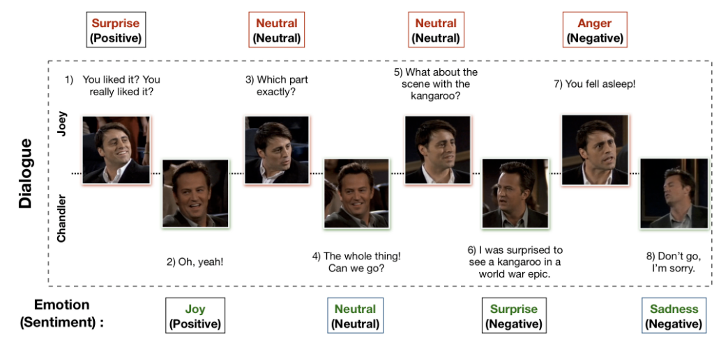
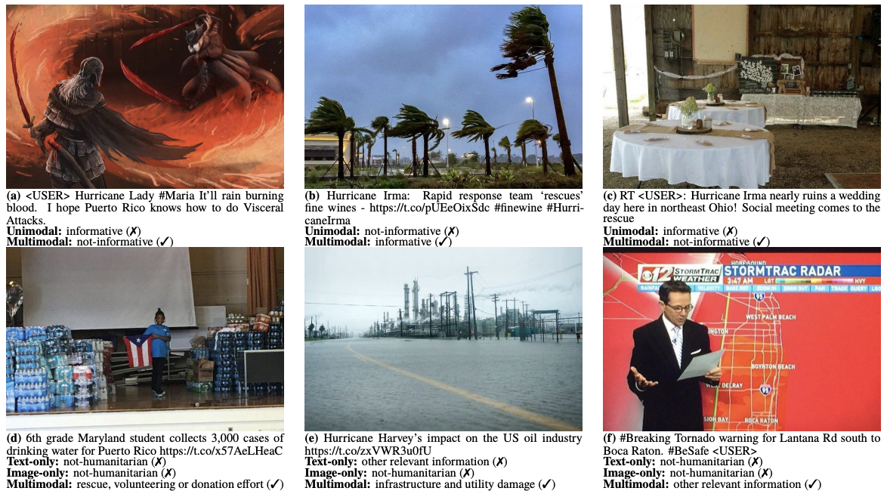
Example of Multi-modal Information Processing
Fig 1: Use of multi-modality for emotion detection in a dialogue
Fig 2: Use of multi-modality for identifying informative tweets

Slide 6
Benefits of Multi-modality
Multiple sensors observing the same data can make more robust predictions
  because detecting changes in it may only be possible when multiple modalities are present
The fusion of multiple sensors can facilitate the capture of complementary information or trends that may not be captured by individual modalities
  For example, in an emotion detector, we could combine information gathered from an EEG (electroencephalogram) and also eye movement signals to combine and classify someone’s current mood—thus combining two different data sources for one deep learning task

Slide 7
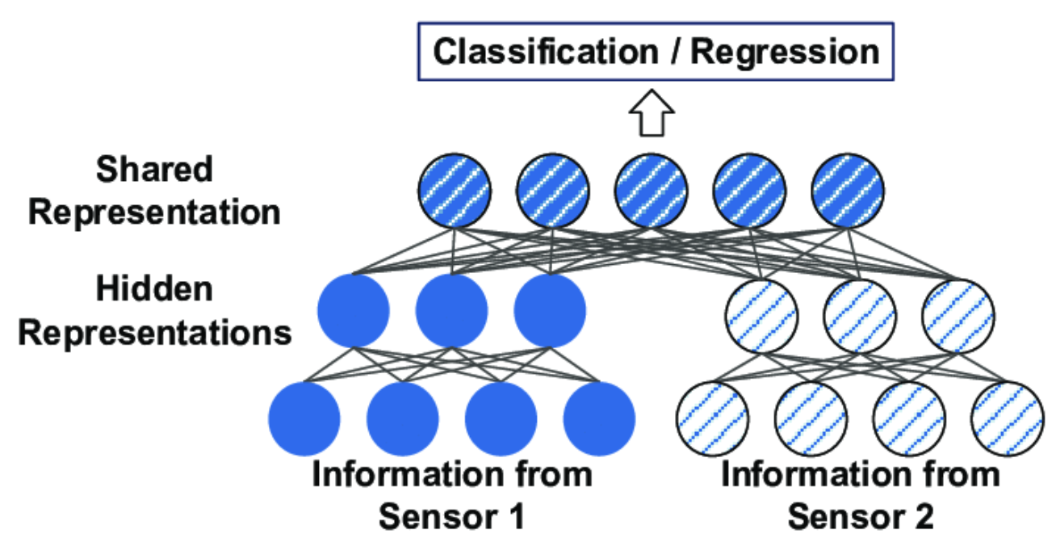
How Multi-modal Learning works?
What we need :
At least two information sources
An information processing model for each source
A learning model for the combined information
Fig 3: Visual representation of multi-modal learning
Source: https://medium.com/haileleol-tibebu/data-fusion-78e68e65b2d1

Slide 8
Types of Multi-modal Information Fusion Techniques
Early fusion or Data-level fusion : referred to as input level fusion
Late fusion or Decision-level fusion
Intermediate fusion
Source: https://medium.com/haileleol-tibebu/data-fusion-78e68e65b2d1

Slide 9
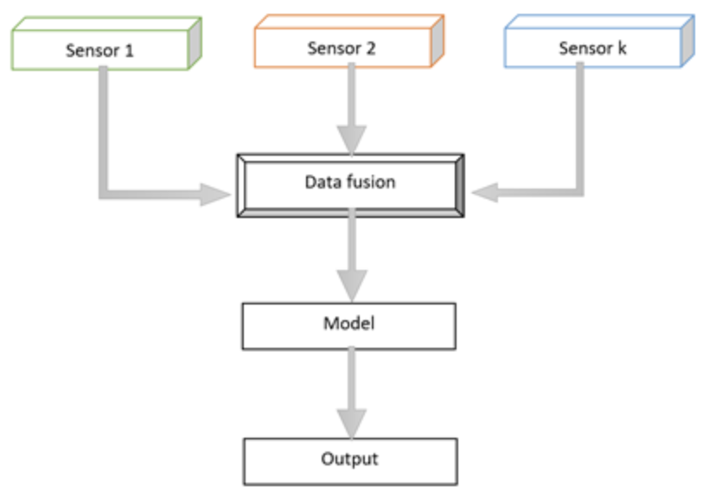
Early fusion or Data-level fusion
Data features are first extracted from individual modalities before fusion especially when the data sources have different sampling rates between the modalities
The assumption behind early data fusion is the conditional independence between multiple data sources
  But this is not always true, as multiple modalities can have highly correlated features, for example video and depth cues
Disadvantages of early stage data fusion
  A large amount of data will be deducted from the modalities to
  make a common ground before fusion
  Synchronizing the timestamp of the different modalities
Source: https://medium.com/haileleol-tibebu/data-fusion-78e68e65b2d1
Fig 4: Visual representation of early data fusion

Slide 10
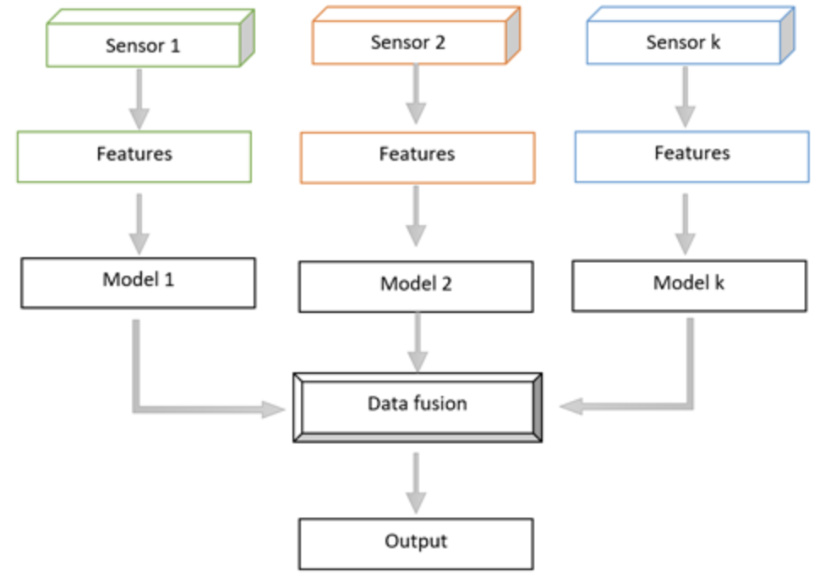
Late fusion or Decision-level fusion
Late fusion process modalities independently followed by fusion at a decision-making stage
This is beneficial when the modalities are significantly varied from each other in terms of sampling rate, data dimensionality and unit of measurement
Late fusion often gives better performance
  because errors from multiple models are dealt
  with independently — thus error are uncorrelated
Source: https://medium.com/haileleol-tibebu/data-fusion-78e68e65b2d1
Fig 5: Visual representation of late data fusion

Slide 11
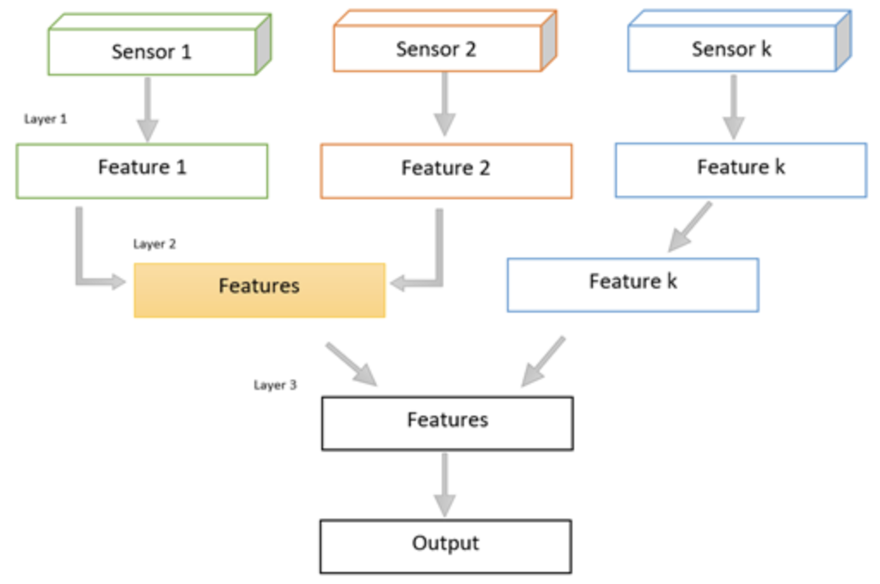
Intermediate fusion
Intermediate fusion in a deep learning multimodal context is a fusion of different modalities representations into a single hidden layer
  so that the model learns a joint representation of each of the modalities
Different modalities can be fused simultaneously into a single shared representation layer or this can be performed gradually using one or multiple modalities at a time
The layer where different modalities are fused is called a fusion layer or a shared representation layer
Source: https://medium.com/haileleol-tibebu/data-fusion-78e68e65b2d1
Fig 6: Visual representation of intermediate fusion

Slide 12
Applications of multimodal information processing
Dialogue systems
  Dialogue act classification---ACL-2020
  Tweet act classification---NAACL 2021
  Developing a sales agent---AACL 2022
  Developing a virtual doctor—CIKM 2022
Complaint Mining---AAAI 2022
  Aspect based complaint mining—ECIR 2023
  Cause extraction---ECML-PKDD 2023
Cyberbully detection---SIGIR 2022
  From memes with explanation—CIKM 2023 (communicated)
  Intervention detection---EMNLP 2023 (communicated)
Summarization
  Supplementary, complementary summarization—ECIR 2020, SIGIR 2021, SIGIR 2020
Rumour Detection—ICDAR 2023

Slide 13
Applications of Multi-modal Information Processing in NLP : “Towards Emotion-aided Multi-modal Dialogue Act Classification”
T. Saha, A. Patra, S. Saha and P. Bhattacharyya (2020), `` Towards Emotion-aided Multi-modal Dialogue Act Classification", In ACL 2020, July 5-10, 2020, Seattle, Washington (Category A*).

Slide 14
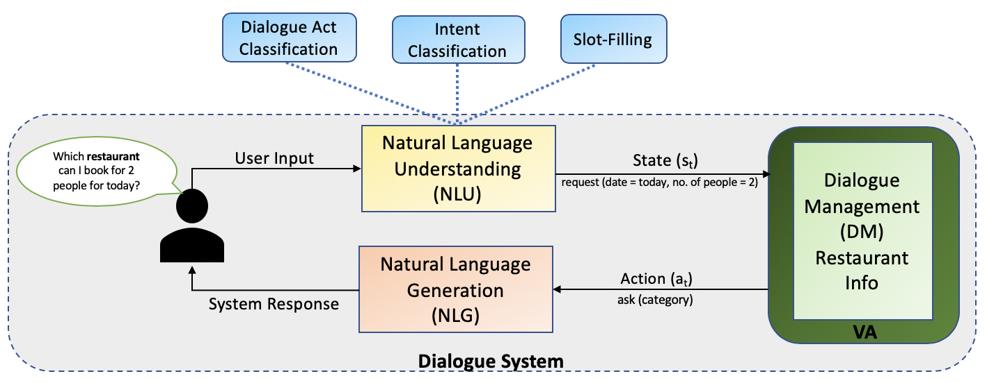
Dialogue System

Slide 15
Dialogue Act Classification
To identify the communicative intention of a speaker in a dialogue conversation classified into a predefined category
For e.g.,
How about you ? Open-question
That's all right. Understanding
I think it is raleigh. Statement
What kind of experience do you, do you have, then with child care? Question
1
2
T. Saha, A. Patra, S. Saha and P. Bhattacharyya (2020), `` Towards Emotion-aided Multi-modal Dialogue Act Classification", In ACL 2020, July 5-10, 2020, Seattle, Washington (Category A*).

Slide 16
Motivation
Primarily all the works in DAC limit themselves to utilizing only the textual modality
Non-verbal features (change of tone, facial expression etc.) can provide useful cues to identify DAs, thus, stressing the role of incorporating multi-modal inputs into the task
The emotional state of the speaker has a substantial effect on its pragmatic content
For eg., utterance such as “Okay sure”, “Ya right” can be considered as agreement or disagreement (if implied sarcastically)
Mostly in expressive DAs such as greeting, thanking, apologizing etc., speaker’s emotion can assist in recognizing communicative intent

Slide 17
Contribution
Curate a new dataset, multi-modal Emotion-DA : EMOTyDA, with high quality annotations of DAs, including emotionally aided cues for facilitating research in multi-modal DAC and lead to a novel sub-task: emotion aware DAC
Propose an attention based (self, inter-modal, inter-task) multi-task, multi-modal deep neural network for jointly optimizing the DAC and Emotion Recognition (ER) tasks. ER has been treated as an auxiliary task aiding the primary task i.e., DAC
Establish that multi-tasking and multi-modality boosted the identification of DAs compared to its single task and uni-modal DAC variants

Slide 18
EMOTION-DA Dataset : EMOTyDA
Data Collection
Scanned the literature for existing multi-modal Emotion Recognition (ER) dataset
Zeroed down on IEMOCAP and MELD datasets
These datasets are not annotated for their corresponding DAs
Data Annotation
SWBD-DAMSL tag-set comprising of 42 DAs used as the basis for conceptualizing tag-set for the EMOTyDA dataset
12 most commonly occurring tags were used to annotate utterances of the EMOTyDA dataset
12 chosen tags are namely Greeting (g), Question (q), Answer (a), Statement-Opinion (o), Statement-Non-Opinion (s), Apology (ap), Command ©, Agreement (ag), Disagreement (dag), Acknowledge (a), Backchannel (b) and Others (oth)
To remove the discrepancy in the number of emotion tags for IEMOCAP and MELD datasets, the joy tag of the MELD dataset was mapped to happy tag of IEMOCAP, to finally settle on 10 emotion tags from IEMOCAP for the EMOTyDA dataset
Conversations from IEMOCAP and MELD dataset were annotated for its corresponding DA tags

Slide 19
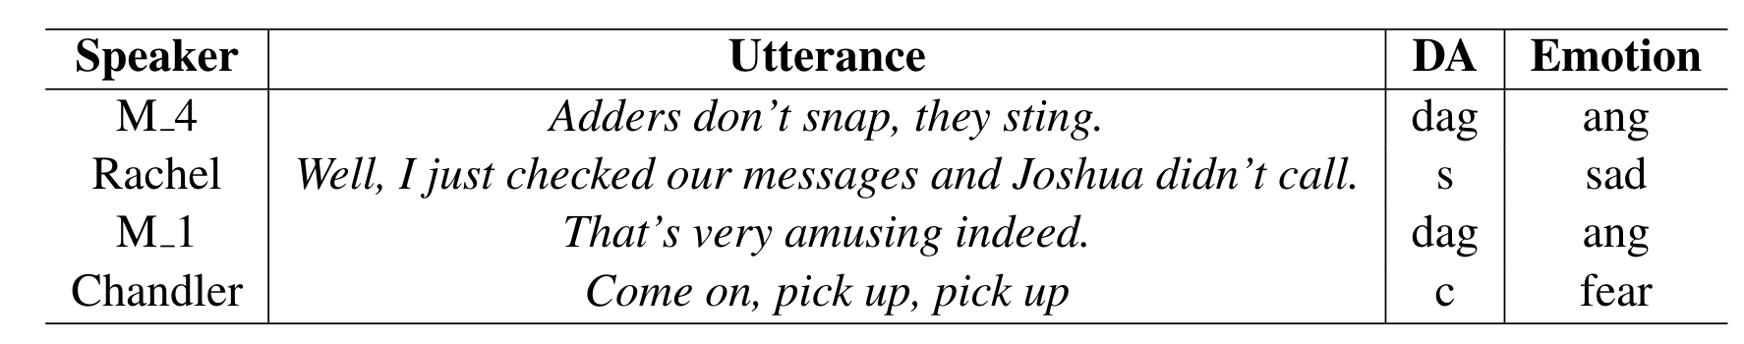
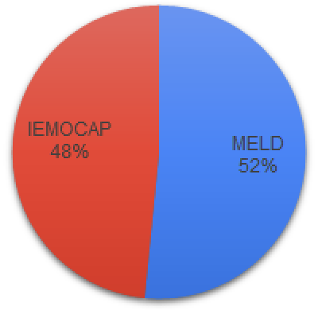
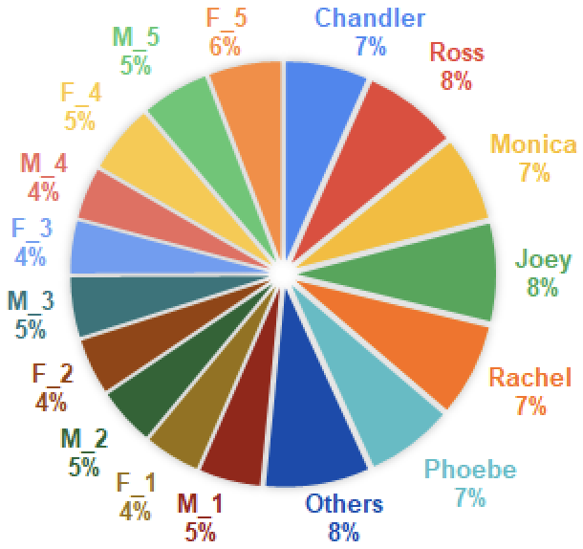
EMOTION-DA Dataset : EMOTyDA
EMOTyDA comprises of 1341 dyadic and multi-party conversations resulting in a total of 19,365 utterances or annotated videos with emotion and DA tags.
Each of the utterances contain three modalities: video, audio and text.
1
2
Table 1. Sample utterances from the EMOTyDA dataset with its corresponding DA and emotion categories
Source across the dataset
Overall Speaker Distribution
Source distribution and major speakers statistics of the dataset

Slide 20
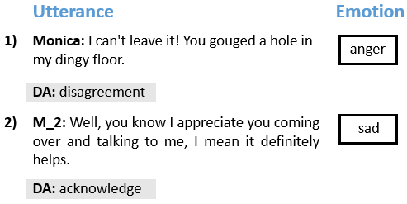
Qualitative Aspects of EMOTyDA
Role of Emotion :
These examples illustrate the importance of having emotional information while deciding the DA of an utterance
The presence of emotion in the dataset caters the models with the ability to use additional information while reasoning about DA
T. Saha, A. Patra, S. Saha and P. Bhattacharyya (2020), `` Towards Emotion-aided Multi-modal Dialogue Act Classification", In ACL 2020, July 5-10, 2020, Seattle, Washington (Category A*).

Slide 21
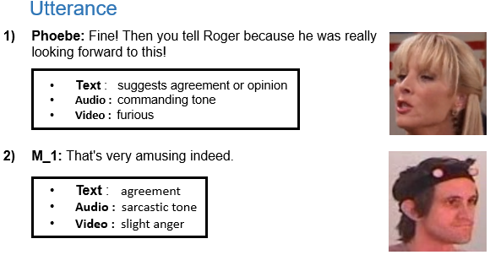
Qualitative Aspects of EMOTyDA
Role of Multi-modality :
In both the examples, there exists inconsistency between modalities, which acts as a strong indicator that multi-modal information is also important in providing additional cues for identifying DAs
The availability of complementary information across multiple modalities improves the model’s ability to learn discriminatory patterns that are responsible for this complex process
1) True DA tag is Command; 2) True DA tag is Disagreement
T. Saha, A. Patra, S. Saha and P. Bhattacharyya (2020), `` Towards Emotion-aided Multi-modal Dialogue Act Classification", In ACL 2020, July 5-10, 2020, Seattle, Washington (Category A*).

Slide 22
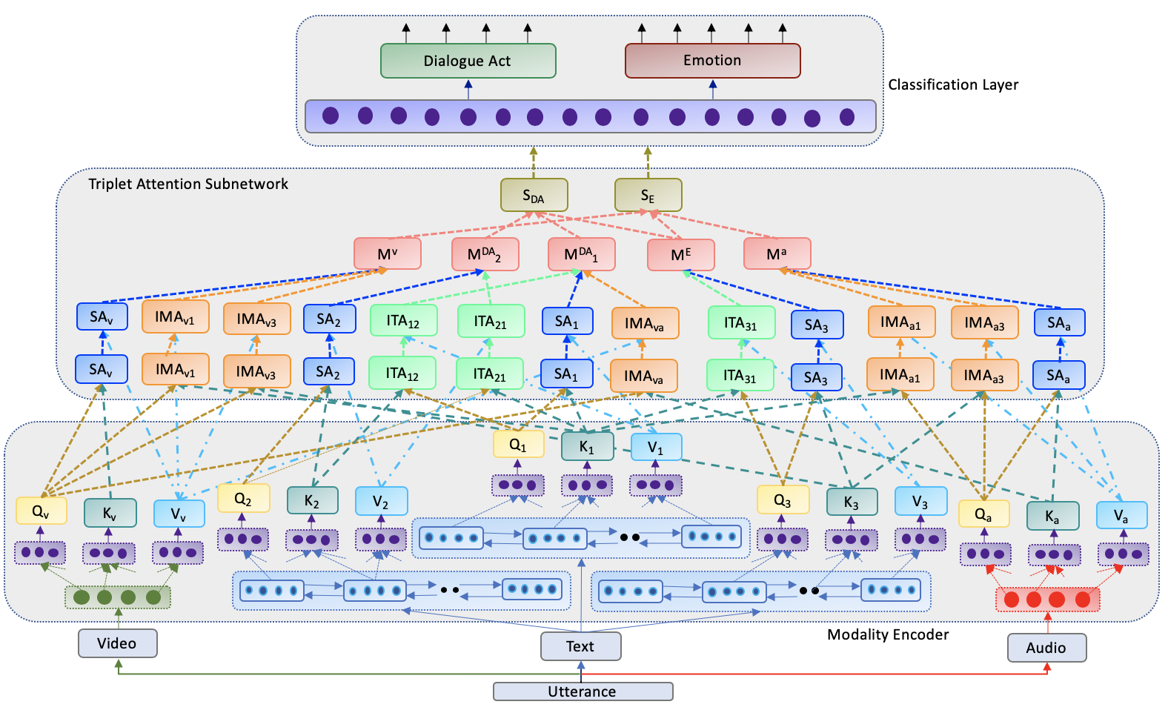
Proposed Methodology
Network Architecture : Classification Layer
The sentence representation for each of the tasks (S_{DA} and S_{E}) from the TAS are connected to a fully connected layer which in turn consists of output neurons for both the tasks (DAC and ER)
The errors computed from each of these channels are back-propagated jointly to successive prior layers of the model to learn joint features of both the tasks

Slide 23
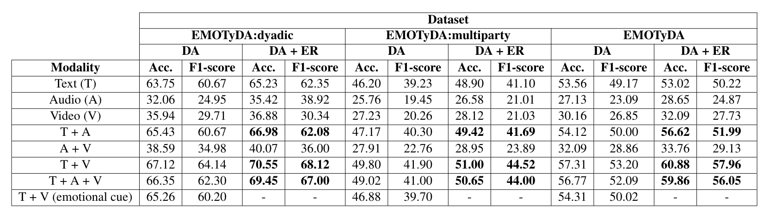
Results and Analysis
Experiments were conducted by segregating dyadic and multi-party conversations as well in addition to the whole dataset for the multi-task framework along with different modalities
Multi-tasking framework performs consistently well compared to its single task DAC variant
Different modalities improve the uni-modal DAC baselines significantly
1
2
3
Table 2. Results of all the baselines and the proposed model in terms of accuracy and F1-score

Slide 24
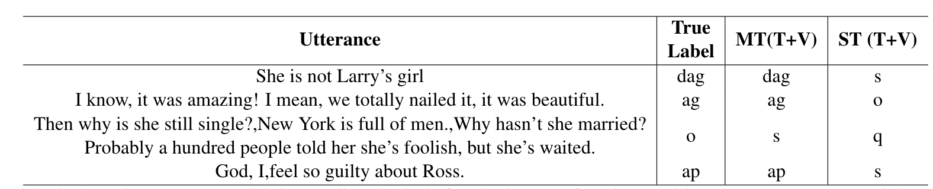
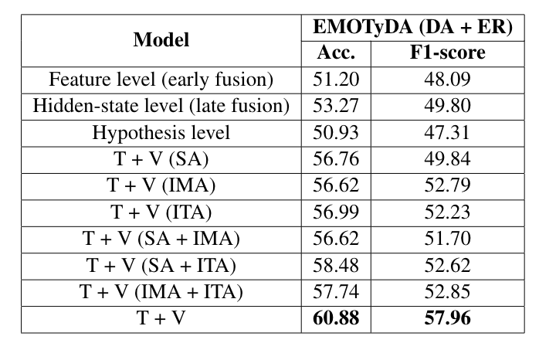
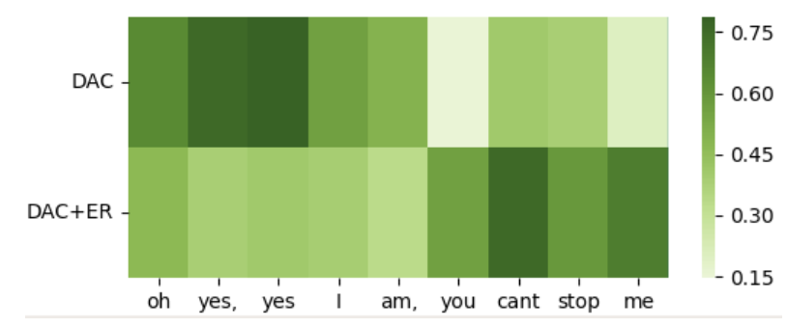
Results and Analysis
Table 3: Error Analysis : Sample utterances with its predicted labels for single task DAC and multi-task models
Table 4: Results of some additional baselines for the multi-task
framework for the EMOTyDA dataset
The visualization of the learned weights for a sample utterance
from the dataset for single task DAC and the multi-task model

Slide 25
Applications of Multi-modal Information Processing in NLP : “Towards Sentiment and Emotion aided Multi-modal Speech Act Classification in Twitter”
T. Saha, A. Upadhyaya, S. Saha, P. Bhattacharyya (2021), ``Towards Sentiment and Emotion aided Multi-modal Speech Act Classification in Twitter", in NAACL-HLT 2021, June 6-11, 2021 ( Category A).

Slide 26
Tweet Act Classification
Speech Act Classification helps in determining the communicative intent of a speaker
This holds true for discussion in any fora including social media platform such as Twitter
Thus, TAC typically helps in determining the communicative intention of a tweeter (someone who tweets)
For e.g.,
@SFEncyclopedia Why the Le Guin title in the gallery? Question
RT @AsafRonel: @LTCPeterLerner @AJEnglishPeter, you should direct just a little bit of your criticism towards the role the Israelis played Suggestion
My dream is to have my boat returned to me, Rashad said. I have been wishing to die every second after my boat died Expression
1
2

Slide 27
Motivation
Primarily all the works in TAC limit themselves to utilizing only the textual modality
Non-verbal cues such as emoji in tweets can provide useful information to identify TAs, thus, stressing the role of incorporating multi-modal inputs into the task
The emotional state of the speaker has a substantial effect on its pragmatic content [9]. Sentiment and emotion are also closely related
For eg., a question or statement is associated with anticipation. An opinion is many times associated with anger or disgust
Mostly in expressive TAs such as expression, request, threat etc., tweeter’s sentiment and emotion can assist in recognizing communicative intent

Slide 28
Contribution
Curate a new dataset, multi-modal Emotion-TA : EmoTA, with high quality annotations of TAs, including emotionally aided cues for facilitating research in multi-modal TAC and lead to a novel sub-task: sentiment and emotion aware TAC
Propose an attention based (Intra-modal, inter-modal) multi-task, multi-modal deep neural network for jointly optimizing the TAC, SA (Sentiment Analysis) and Emotion Recognition (ER) tasks. SA and ER have been treated as auxiliary tasks aiding the primary task i.e., TAC
Establish that multi-tasking and multi-modality boost the identification of TAs compared to its single task and uni-modal TAC variants

Slide 29
EMOTION-TA Dataset : EmoTA
Data Collection
Scanned the literature for existing Sentiment Analysis (SA) and Emotion Recognition (ER) dataset for Twitter
Zeroed down on SemEval-2018 dataset
This dataset is not annotated for their corresponding sentiment and TA tags
Data Annotation
Made use of 7 TA categories of [Saha et al.,2019] for annotating EmoTA dataset as opposed to 5 and 6 TA categories of [Zhang et al.,2011] and [Vosoughi and Roy, 2016] respectively
7 TA tags are namely, Statement (sta), Expression (exp), Question (que), Request (req), Suggestion (sug), Threat (tht) and Others (oth)
A subset of SemEval-2018 dataset amounting to 6810 tweets were selected to create EmoTA dataset
A semi-supervised approach was adopted to annotate sentiment labels instead of manual annotation which is cost-intensive
Used the IBM Watson Sentiment Classifier, an open-sourced API readily available for obtaining silver standard sentiment label of the tweets categorized into 3 tags namely, Positive (pos), Negative (neg) and Neutral (neu)
The SemEval-2018 dataset is pre-annotated for its emotion labels : contain 11 multi-label emotion categories
T. Saha, S. Saha and P. Bhattacharyya (2019): Tweet Act Classification : A Deep Learning based Classifier for Recognizing Speech Acts in Twitter, IEEE International Joint Conference on Neural Networks (IJCNN) 2019, Budapest, Hungary, July 14-19, 2019

Slide 30
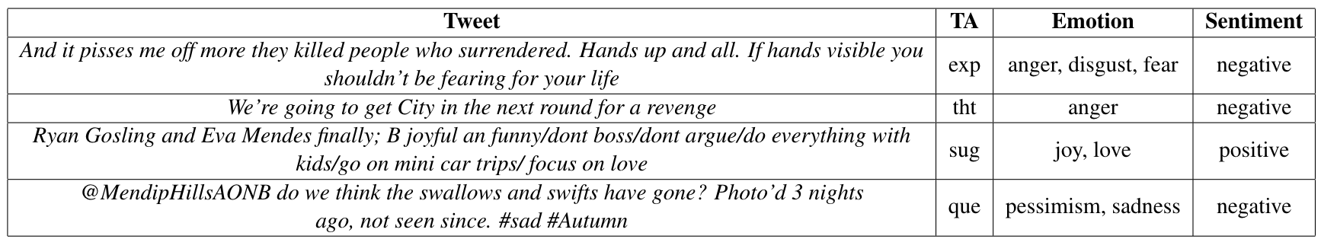
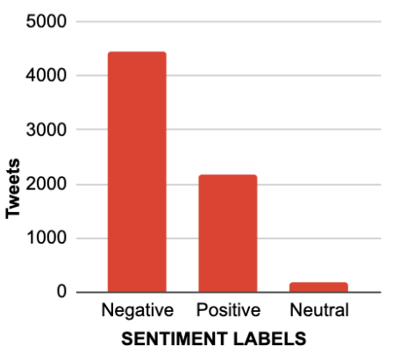
EMOTION-TA Dataset : EmoTA
EmoTA comprises of 6810 tweets with the corresponding gold standard TA and multi-label emotion tags
Each of the tweets contain two modalities: text and emoji
1
2
Table 1. Sample tweets from the EmoTA dataset with its corresponding TA, emotion and sentiment categories
Distribution of sentiment labels of the dataset

Slide 31
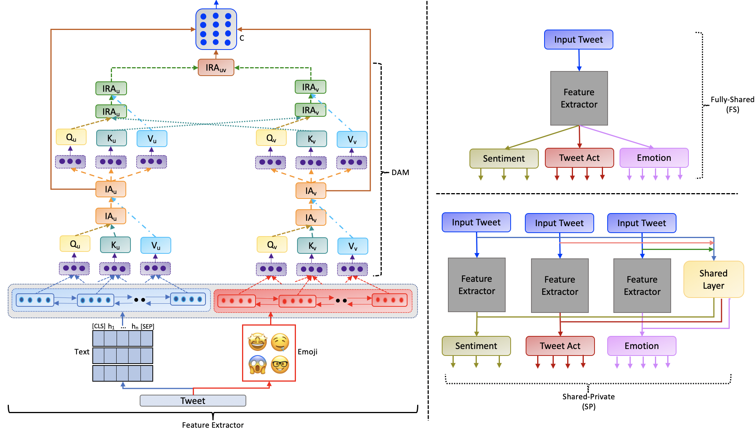
Proposed Methodology

Slide 32
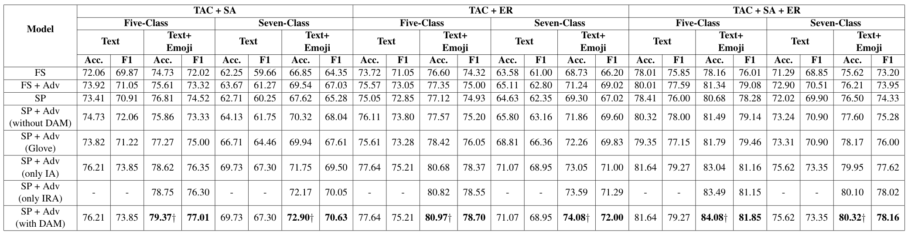
Results and Analysis
Experiments were conducted in two different set-up : Five-class and Seven-class classification for the multi-task framework along with different modalities
Multi-tasking framework performs consistently well compared to its single task TAC variant
Different modalities improves the uni-modal TAC baselines significantly
1
2
3
Table 2. Results of all the baselines and the proposed multi-task models in terms of accuracy and F1-score

Slide 33
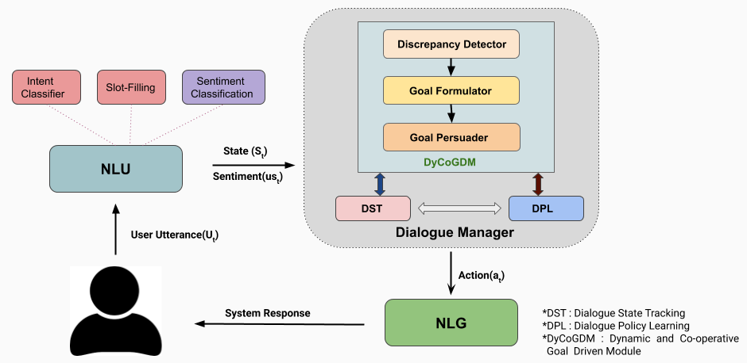
A Persona aware Persuasive Dialogue Policy for Dynamic and Co-operative Goal Setting¹
Problem : Goal unavailability ; existing task oriented agents completely flatter in case of goal unavailability scenarios.
Idea : In real words, agents do not give up in goal unavailability scenarios, they find a very close and servable goal and persuade end users for the new goal.
Contribution :
Dynamic Goal adapted VA
Framework for Co-operative Goal Setting
Reward Model : TR + SR + PR
¹ Tiwari, A., Saha, T., Saha, S., Sengupta, S., Maitra, A., Ramnani, R., & Bhattacharyya, P. (2021, July). Multi-Modal Dialogue Policy Learning for Dynamic and Co-operative Goal Setting. In 2021 International Joint Conference on Neural Networks (IJCNN) (pp. 1-8). IEEE.

Slide 34
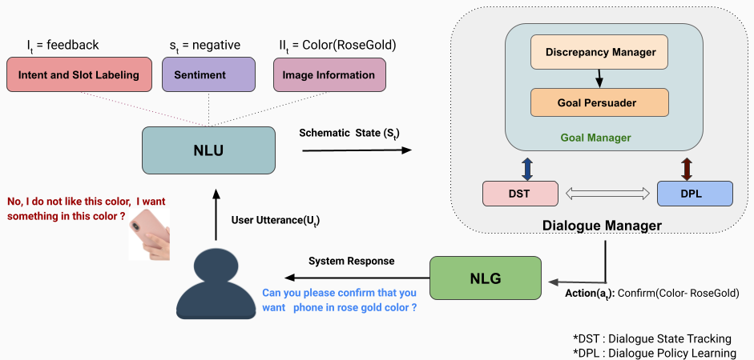
Proposed Model
Proposed end to end multi modal framework for dynamic and co-operative goal setting

Slide 35
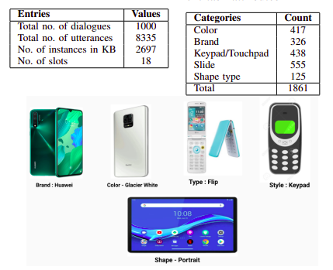
Dataset

Slide 36
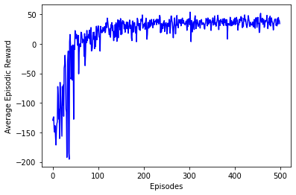
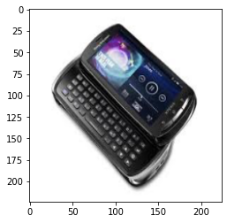
Results & Discussion
Agent | Success rate | Avg. Dialogue Len | Avg. Reward
Random Agent | 0.002 | 17.24 | -240.41
Rule Agent | 0.000 | 14.00 | -234.26
HDRL-M | 0.071 | 15.10 | -1.34*
UDP | 0.468 | 14.81 | -72.50
UPDP_{TR} | 0.672 | 11.04 | 31.55
UPPDP_{TR + PR} | 0.766 | 9.92 | 35.47
MM-UPPDP_{TR+PR} | 0.784 | 8.76 | 36.28
MM-UPPDP_{TR+PR+SR} | 0.793 | 8.56 | 37.30
Learning Curve : Avg. Episodic Reward over Episodes
The proposed agent continue to serve users even in case of goal unavailability and persuades them on some persona aligned feature.
TR + SR + PR ⇒ Task oriented, user adaptive and persuasive behav
Image Identification error
Comparative study of performances of different baselines and the proposed agent (MM-UPPDP)
Predicted : Keypad, Tag : Slide

Slide 37
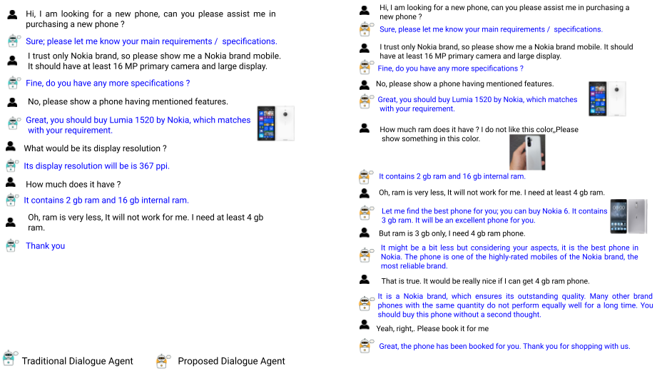
Persona or Context ? Towards Building An User adaptive Persuasive Multimodal Dialogue System¹
Problem : Persuasion is a very subjective concern that largely depends on persuadee's personality and persuasion target ;
A person ⇒ Context 1 ⇒ T ⇒ ✔ ; Same person ⇒ Context 2 ⇒ T ⇒ ✘
Idea :
Personalized [Context guided Personality aware] Persuasion
Contribution :
A novel end-to-end multimodal task-oriented dialogue framework with personalized persuasive strategy aided dynamic and cooperative goal controller and goal persuader
Persuasiveness Measure Rate (PMeR)
Personalized persuasive dialogue corpus
¹Tiwari, A., Saha, S., Sengupta, S., Maitra, A., Ramnani, R., & Bhattacharyya, P. (2022, November). Persona or Context? Towards Building Context adaptive Personalized Persuasive Virtual Sales Assistant. In Proceedings of the 2nd Conference of the Asia-Pacific Chapter of the Association for Computational Linguistics and the 12th International Joint Conference on Natural Language Processing (pp. 1035-1047).

Slide 38
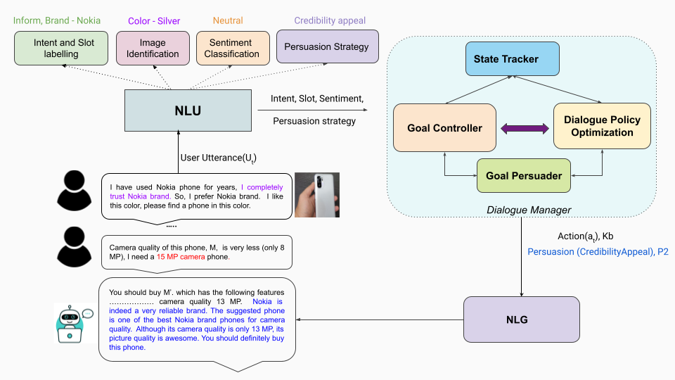
Proposed Model
Proposed framework for Personalized Persuasive Multimodal Dialogue (PPMD) system

Slide 39
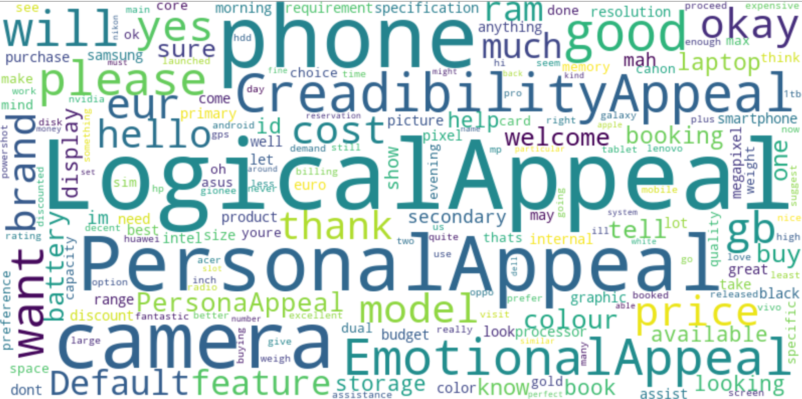
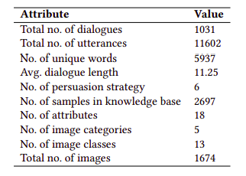
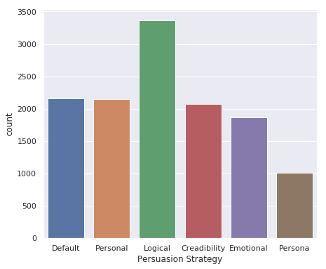
Dataset
Dataset statistics

Slide 40
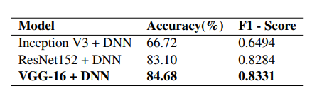
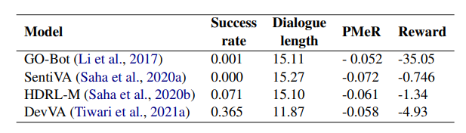
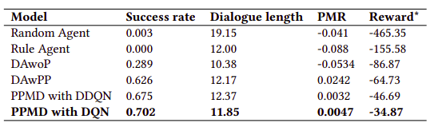
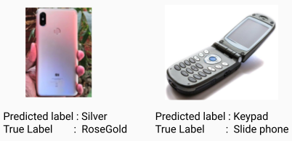
Results & Discussion
Performance of Image Identifier
Performance of state-of-the-art models for the proposed task
Performance of different baseline and proposed personalized persuasive multimodal dialogue (PPMD) agents
Findings and Analysis
The proposed context aware personalized persuasive agent outperforms both the agents w/o persuasion and persuasion with fixed strategy.
Role of Context - Yes, context Helps ! : Persuasive Strategy classifier
Image identification error

Slide 41
Introduction
“ Investigation of role of Human-inspired Learning in Developing Intelligent Virtual Assistants”
Virtual Assistants
Humans Computers : Task oriented Virtual Assistant
Human Inspired Learning
Learn a task more effectively and quickly if guided by an experienced
Individual / learning guidelines.
Human behaviour /experience → Data →Machine Learning / Deep Learning → Virtual Assistant
Data + Human Learning Principles Virtual Assistant
Intelligent
  Successful task accomplishment*
  Task accomplishment in less time
  Learning from failed attempts
Personal
Assistant
Virtua
Counselor
Task
E-commerce
Virtual Agent
Sales Agent
Diagnosis Agent
Customer
Service
ML/DL
* Necessity * Curiosity

Slide 42
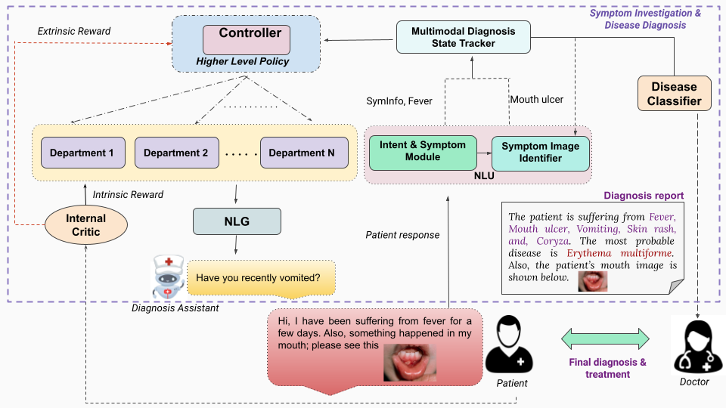
Dr. Can See : Towards Multimodal Automatic Disease Diagnosis Virtual Assistant¹
Problem : In real-world, when we consult with doctors, we often report and describe our difficulties or symptoms with visual aids.
Idea :
Symptom Image aided Symptom Investigation and Diagnosis
Dialogue Context aware Symptom Image Identification
Contribution :
A Multimodal Disease Diagnosis Virtual Assistant (MDD-VA) using hierarchical reinforcement learning
Dialogue Context aware Symptom Image Identification
Multimodal Diagnosis Dialogue Data
Proposed Multimodal Disease Diagnosis Framework
¹Tiwari, A., Manthena, M., Saha, S., Bhattacharyya, P., Dhar, M., & Tiwari, S. (2022, October). Dr. Can See: Towards a Multi-modal Disease Diagnosis Virtual Assistant. In Proceedings of the 31st ACM international conference on information & knowledge management (CIKM 2022)

Slide 43
Research Questions
Can a diagnosis assistant diagnose patients more effectively and satisfactorily if it considers patients' visual descriptions in addition to text-based symptoms?
Will patients' self-reports via text and images be enough to diagnose them correctly?
Can dialogue context help in interpreting an image that surfaced during conversation?

Slide 44
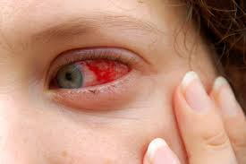

User Intent and Symptom
<SymptomInfo>
Yes: O I: O have: O been: O experiencing: O eye: B-Symptom pain: I-Symptom
for: O a: O few: O days: O Also: O please: O see: O my: O eye: O
Context aware Symptom Image Identification
Multi modal semantic state
eye redness
Softmax
Linear
Symptom
O
O
B-Sym
……...
O
Concatenation
TRM
TRM
TRM
TRM
TRM
TRM
Context
Embedding
Visual features
E₁
E₂
E₃
E₄
……...
E_{T-1}
E_{T}
PII
Clinical Bio-BERT
[CLS]
I
have
eye
……...
eye
[SEP]
Cloudy Vision
Yes, I have been experiencing eye pain for a few day. Also, please see my eye
U^{t}_{text}
U^{t}_{img}
U_{1:t-1}
Patient

Slide 45
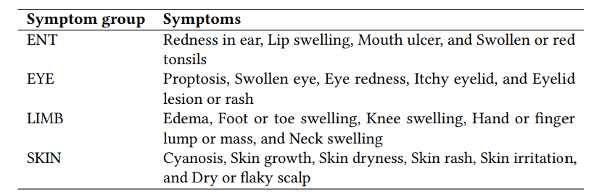
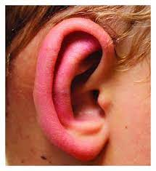
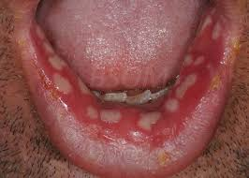
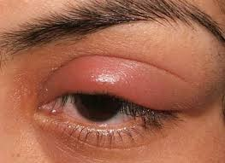
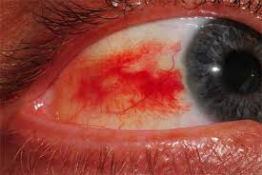
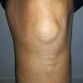



Hierarchical Symptom Image Classifier
HSII
ENT
EYE
LIMB
SKIN
Hierarchical Symptom Image Identifier (HSII)

Slide 46



Dataset
Dataset Statistics
A conversation from Vis-MDD dataset
Few multimodal symptoms

Slide 47


Results & Discussion
Performance of different diagnosis agents : Our proposed model, MDD-VA outperforms all the baselines and state-of-the-art model (HLR) across all evaluation metrics
Performance of Symptom Image Classifiers
Key Findings
Improvement over uni-modal baselines and state-of-the-art model ; Human satisfaction ⇒ Role of Multimodality :Symptom Extraction
Positive correlation between between diagnosis success rate and dialogue length ⇒ Success rate and Symptom investigation time
YES, DIALOGUE CONTEXT helps in identifying patient provided symptom image; Importance of Context window ⇒ Role of dialogue context

Slide 48
Tools and Techniques for
Complaint Mining

Slide 49
What is Complaint?
Complaining is a speech act used to express a negative mismatch between reality and expectations towards a state of affairs, product, organization or event [1].
An individual’s emotional state has a significant impact on the complaint expression since emotions generally influence any speech act
Automatic classification of complaint texts in natural language is of extreme significance for:
– linguists to acquire a better grasp of the specific context, purpose
– developers of downstream natural language processing applications, such as dialogue systems [2].
Example | Complaint | Sentiment
I love Boots! Shame you’re introducing a man tax of 7% in 2018 :( | Yes | Yes
You suck! | No | Yes

Slide 50
Complaints on Social Media
One-third of all customer complaints are never answered, most of them are in social
Answering a complaint increases customer advocacy by as much as 25%
Not answering a complaint decreases customer advocacy by as much as 50%
From 2020 to 2021 alone, the volume of consumers who preferred using social messaging for customer service jumped an impressive 110%.
Most questions are about product availability and payment methods, but a few are feedback about the products or the buying process.
Based on social media trends if companies fail to offer timely resolutions on social, almost half of consumers may unfollow your brand
Even worse, over a third will talk about the experience with their family and friends
Source: https://sproutsocial.com/insights/social-media-customer-service-statistics/ and https://www.zendesk.com/in/cx-trends-report/#georedirect
Notes:
Customer advocacy is the act of building and nurturing relationships with loyal customers, who then act as spokespeople and champions for your brand, products, or services.

Slide 51


Social Media Complaints Statistics
Source:https://www.convinceandconvert.com/social-media/your-poor-customer-service/
Notes:
Customer advocacy is the act of building and nurturing relationships with loyal customers, who then act as spokespeople and champions for your brand, products, or services.

Slide 52



Complaints and Social Media
Notes:
Customer advocacy is the act of building and nurturing relationships with loyal customers, who then act as spokespeople and champions for your brand, products, or services.

Slide 53
Motivation for Complaint Detection
  Timely and effective identification of customer’s complaints is vital to provide immediate resolution to improve customer satisfaction for any organization.
  Establishing computer systems to mimic human-like understanding of complaints and non-complaints becomes onerous given their lack of human perception and knowledge.
  Detecting complaints on social media additionally necessitates detecting complaints from fragmented and noisy text snippets with character limits, interpretation of implicit expressions, irony, and colloquialism.
  There are very few gold-standard complaint datasets available publically.

Slide 54
Sentiment and Emotion-Aware Multi-Modal Complaint Identification
Apoorva Singh, Soumyodeep Dey, Anamitra Singha, Sriparna Saha
A. Singh, S. Dey, A. Singha, S. Saha: Sentiment and Emotion-Aware Multi-Modal Complaint Identification. AAAI 2022: 12163-12171

Slide 55

Sentiment and Emotion-Aware Multi-modal Complaint Identification
Motivation:
Nowadays, every e-commerce platform allows users to accompany an opinion or review with various media formats, exemplifying the superiority of a multi-modal form of communication.
Multi-modal information sources (e.g., images in addition to text) could provide more information in identifying complaints
Amazon delivered expired product, fungus infested. Hate such service it’s unbelievable! Product not worth it, throwing into dustbin.
Emotion: Anger
Sentiment: Negative
Complaint
Figure 3: Significance of multi-modality, emotion and sentiment information

Slide 56
Sentiment and Emotion-Aware Multi-modal Complaint Identification
Contribution
We curate a new dataset called Complaint, Emotion, and Sentiment Annotated Multi-modal Amazon Reviews Dataset (CESAMARD) for aiding multi-modal complaint identification research.
We propose a dual attention-based multi-task adversarial learning framework for multi-modal complaint, emotion,and sentiment analysis.
We present the state-of-the-art for automatically identifying complaints in the multi-modal scenario.
About CESAMARD
We initially gathered reviews from Amazon² India’s website.
CESAMARD³ dataset consists of product reviews with user-uploaded images with manual annotations of complaint, emotion and sentiment classes.
The dataset now comprises of 3962 reviews. It consists of 2641 reviews in the non-complaint category and 1321 reviews in the complaint category.
2. https://www.amazon.in/
3. https://www.iitp.ac.in/~ai-nlp-ml/resources.html#CESAMARD

Slide 57
CESAMARD Dataset
Emotion | Complaints | Non-Complaints
Anger | 425 | 0
Disgust | 120 | 0
Fear | 27 | 0
Happiness | 0 | 2560
Sadness | 710 | 46
Surprise | 39 | 35
Total | 1321 | 2641
Sentiment | Complaints | Non-Complaints
Negative | 949 | 66
Neutral | 369 | 545
Positive | 0 | 2030
Total | 1321 | 2641
Table 5: Distribution of sentiment labels across the dataset.
Table 4: Distribution of emotion labels across the dataset.

Slide 58



Sample Instances from the Dataset
Instances | Images | Domain | Labels | Sentiment | Emotion
Received the book and started reading it after a few weeks. Many pages of the book are blank and not readable due to poor printing quality. Disappointed! |  | Books | Com | Negative | Sadness
Food Damaged by pests not acceptable, kindly avoid purchasing online items where food is concerned. Yuck! |  | Edibles | Com | Negative | Disgust
All in all this product was satisfying and I’m happy with my purchase from Urbano. Product looks new and nice and comfortable too. |  | Fashion | Non-Com | Positive | Joy

Slide 59

Multimodality and Supplementary Tasks Significance
Figure 4: (a) Significance of multi-modality, (b) Significance of emotion and sentiment

Slide 60

Figure 5: The Multi-modal Complaint Identification (MCI) framework. smax: softmax activation function.

Slide 61
Results
Models | Text |  | Text+Image
Metrics | F1 (%) | Acc (%) | F1 (%) | Acc (%)
SOTA[7] | 83.18± .08 | 83.39± .12 | - | -
STL_{T} | 83.05± .06 | 84.59± .06 | - | -
STL_{T+I} | - | - | 85.14± .13 | 85.26± .05
Multi-task Baselines
MTL_{T} | 83.09 ± .03 | 84.22 ± .06 | - | -
MTL_{T+I} | - | - | 84.25 ± .04 | 85.53 ± .08
BSPMF_{T}[8] | 87.04 ± .03 | 87.91 ± .04 | - | -
Multi-modal baseline
BMML | - | - | 88.38± .03 | 88.50± .05
MCI_{CE} | - | - | 87.18± .12 | 86.85 ± .04
MCI_{CS} | - | - | 86.20± .06 | 85.93± .04
MCI_{AS} | - | - | 85.13± .08 | 86.35± .05
MCI_{AC} | - | - | 86.25± .06 | 87.32± .14
Proposed Approach
MCI | - | - | 89.07* ± 0.04 | 89.64* ± 0.04
Proposed model and baseline results

Slide 62
Error Analysis
Ironical Instances: Instances having irony or comments where the underlying tone is positive or neutral, but the instance is of complaint type, the MCI model inaccurately predicts such instances as complaint.
Example: “Biscuits with oil might be a rare combination of Amazon nowadays.”
Multifold Sentences: Many of the sentences in the CESAMARD dataset are lengthy and heterogeneous in nature, including diverse emotions in a single review. In such scenarios, learning specific complaint features becomes challenging.
Example: “Although it’s not a Microsoft genuine product, it’s good quality and comfortable to use. Price is really reasonable too when compared to its build quality and features.”
Biasness towards Non-Complaint class: Model mostly mis-classifies the minority complaint class (33%) as it is underrepresented in comparison to the non-complaint class.

Slide 63
Knowing What and How: A Multi-modal Aspect-Based Framework for Complaint Detection
Apoorva Singh, Vivek Gangwar, Sriparna Saha
European Conference on Information Retrieval (ECIR), 2023

Slide 64
Aspect-Based Framework for Complaint Detection
Motivation
Analyzing complaints at the aspect-level, enterprises can customize products and services according to their needs quickly and deftly.
Example: “The packaging of the product is great, but the taste is pathetic.”
Prior studies identify the overall document or sentence-level complaints, which are sometimes insufficient for companies for research and development of existing and new products
Contribution
We propose the task of aspect-guided complaint classification in a multi-modal setup.
We extend the multi-modal complaint dataset⁵ (CESAMARD) by annotating the aspect categories and associated complaint/non-complaint labels.
We proposed a multi-modal bi-transformer for aspect-guided complaint classification.
Aspect-based complaint detection (ABCD) model surpasses a few strong baselines developed from state-of-the-art based methods.
5. Dataset is available here: https://github.com/appy1608/ECIR2023_Complaint-Detection

Slide 65
ABSA vs. ABCA
Aspect-based Sentiment Analysis (ABSA) and Aspect-based Complaint Analysis (ABCA) are two related but distinct techniques in natural language processing.
Organizations can benefit greatly from ABCA for three primary reasons:
1) Purpose: ABSA is mainly used by businesses to understand customer satisfaction and gain insights into which aspects of their products or services are most valued by customers. ABCA can be used to specifically identify complaints at the aspect level and take action to address them.
2) Scope: ABSA can only be used to analyse positive and negative sentiment, while ABCA can be used to identify complaints with explicit as well as implicit negative sentiment. For example:
"I noticed that my order was missing a side dish. Can you please add that to my order?"
3) Output: ABSA typically produces a sentiment score or a sentiment label for each aspect of a product or service, while ABCA produces a list of specific complaints at the aspect level.

Slide 66
Extended CESAMARD Dataset (CESAMARD-Aspect)
For our experiments, we used the recently introduced CESAMARD dataset [1]. It consists of 2641 non-complaint and 1321 complaint reviews in English.
We extended this dataset¹ by introducing aspect categories and aspect category complaint labels for each review instance.
Domains | Instances | Aspect Categories
Books | 690 | Content, Packaging, Price, Quality
Edibles | 450 | Taste, Smell, Packaging, Price, Quality
Electronics | 1507 | Design, Software, Hardware, Packaging, Price, Quality
Fashion | 1275 | Colour, Style, Fit, Packaging, Price, Quality
Resources available at: https://github.com/appy1608/ECIR2023_Complaint-Detection

Slide 67



Sample Instances from the Dataset
Tweets | Images | Aspect Categories | Labels
Taste of lentil was very good but received torn package. |  | Taste Packaging | Non-Com Com
Ordered blue colour but received red colour t-shirt!? |  | Colour | Com
Received a defective piece; now not able to give for replacement also. |  | Quality Service | Com Com

Slide 68

The architectural diagram of aspect-based complaint detection framework

Slide 69
Results
Domain | Model | ACD |  | ACC
 |  | Micro-F1 | Macro-F1 | Accuracy | Macro-F1
Books | Text | 60.45 | 52.89 | 73.61 | 72.19
 | Image | 31.25 | 29.97 | 47.77 | 45.57
 | Text & Image | 66.04 | 60.31 | 74.78 | 73.05
 | SOTA [8] | 62.09 | 57.88 | 77.42 | 76.28
 | ViLBERT | 71.34 | 68.41 | 77.84 | 76.78
 | ABCD | 71.54 | 68.18 | 78.96 | 78.03
Edibles | Text | 59.08 | 55.87 | 74.38 | 72.02
 | Image | 33.47 | 29.87 | 48.52 | 47.22
 | Text & Image | 61.03 | 57.89 | 78.95 | 77.67
 | SOTA [8] | 63.78 | 59.98 | 78.73 | 78.41
 | ViLBERT | 65.79 | 61.05 | 81.28 | 79.18
 | ABCD | 65.98 | 62.09 | 81.94 | 80.03
Domain | Model | ACD |  | ACC
 |  | Micro-F1 | Macro-F1 | Accuracy | Macro-F1
Electronics | Text | 67.45 | 59.87 | 77.51 | 76.76
 | Image | 35.55 | 31.89 | 50.78 | 49.17
 | Text & Image | 68.88 | 65.49 | 79.48 | 78.12
 | SOTA [8] | 69.88 | 63.56 | 81.34 | 78.27
 | ViLBERT | 71.89 | 65.87 | 82.46 | 80.28
 | ABCD | 72.56 | 68.25 | 84.57 | 84.08
Fashion | Text | 65.56 | 59.14 | 76.59 | 74.77
 | Image | 32.43 | 30.12 | 46.56 | 44.06
 | Text & Image | 66.45 | 61.51 | 78.08 | 77.62
 | SOTA [8] | 65.78 | 59.08 | 81.23 | 80.04
 | ViLBERT | 70.48 | 65.67 | 83.37 | 82.07
 | ABCD | 70.84 | 69.32 | 84.27 | 83.25
Proposed model and baseline results

Slide 70
Aspect-based Complaint and Cause Detection: A Multimodal Generative Framework with External Knowledge Infusion
Raghav Jain, Apoorv Verma, Apoorva Singh, Vivek Gangwar, Sriparna Saha
European Conference on Machine Learning and Principles and Practice of Knowledge Discovery (ECML PKDD), 2023

Slide 71

Aspect-Based Framework for Complaint Detection
Motivation
Earlier studies face two main challenges which are
aspect information
reason/rationale of the complaint at the aspect-level
For example, if a user dislikes an online purchased edible product, it may not be evident 'what' aspect the user finds problematic or 'why' the user is complaining
Example of aspect-based complaint and cause detection. Highlighted text: causal span of complaint for the packaging aspect.

Slide 72
Aspect-Based Framework for Complaint Detection
Contribution
We propose the novel task of aspect-based complaint and rationale detection in a multimodal setup.
We enhance the existing CESAMARD⁶ dataset by annotating the causal span for each aspect-level complaint instance.
We propose a knowledge-infused Multimodal Generative framework, which addresses aspect category detection (ACD), aspect-level complaint classification (label), and aspect-level rationale detection (causal span).
6. Dataset is available here: https://anonymous.4open.science/r/ecml-571B

Slide 73


Sample Instances from the Dataset
Tweets | Images | Aspect Categories | Labels | Causal Span
Product quality is quite good but didn’t like the fit, tight on shoulders. |  | Quality Fit | Non-Com Com | Nan tight on shoulders
Package torn near zipper, spillage noticed. Complained, got no response. Pathetic service |  | Package Service | Com Com | torn near zipper got no response

Slide 74

Figure 9: Architectural diagram of the proposed Multimodal Generative Aspect-based complaint and Cause Detection framework

Slide 75


Results
Table 2: Ablation Study results
Table 1: Proposed model and baseline results

Slide 76
Recent Publications
A. Tiwari, S. Saha, S. Sengupta, A. Maitra, R. Ramnani and P. Bhattacharyya (2022), ``Persona or Context? Towards Building Context adaptive Personalized Persuasive Virtual Sales Assistant", in AACL-IJCNLP 2022.
S. Mukherjee, A. Jangra, S. Saha, and A. Jatowt (2022), ``Topic-aware Multimodal Summarization", in AACL-IJCNLP Findings 2022.
P. Jha, Gael Dias, A. Lechervy, Jose G Moreno, A. Jangra, S. Pais, S. Saha (2022), ``Combining Vision and Language Representations for Patch-based Identification of Lexico-Semantic Relations", in ACM Multimedia, 10-14 October 2022, Lisbon, Portugal (category A*).
T. Saha, S. M. Reddy, A. S. Das, S. Saha, P. Bhattacharyya (2022), ''A Shoulder to Cry on: Towards A Motivational Virtual Assistant for Assuaging Mental Agony ", in NAACL 2022 (core rank A).
R. Kumar, S. Mathias, S. Saha , P. Bhattacharyya (2022), ``Many Hands Make Light Work: Using Essay Traits to Automatically Score Essays", in NAACL 2022 (core rank A).
K. Maity, P. Jha, S. Saha, P. Bhattacharyya (2022), ``A Multitask Framework for Sentiment, Emotion, and Sarcasm aware Cyberbullying Detection in Multi-modal Code-Mixed Memes", in SIGIR 2022 (core rank A*).
T. Saha, V. Gakhreja, A. S. Das, S. Chakraborty, S. Saha (2022), ``Towards Motivational and Empathetic Response Generation in Online Mental Health Support", in SIGIR 2022 (core rank A*).
A Singh, S. Dey, A. Singha, S. Saha (2021), ``Sentiment and Emotion-aware Multi-modal Complaint Identification", in AAAI 2022 (core rank A*).
A. Singh, A. Nazir, S. Saha (2021), ``Adversarial Multi-task Model for Emotion, Sentiment, and Sarcasm aided Complaint Detection", in 44th European Conference on Information Retrieval (10-14 April 2022), ECIR 2022 (core ranking A), Norway.
R. Jain, V. Mavi, A. Jangra, S. Saha (2021), ``WIDAR - Weighted Input Document Augmented ROUGE", in 44th European Conference on Information Retrieval (10-14 April 2022), ECIR 2022 (core ranking A), April 10-14, 2022, Norway.
S. Pingali, S. Yadav, P. Dutta, and S. Saha (2021), ``Multimodal Graph-based Transformer Framework for Biomedical Relation Extraction", in ACL Findings 2021, August 2-4, 2021 ( Category A*).
A. Jangra, S. Saha, A. Jatowt and M. Hasanuzzaman (2021), ``Multi-Modal Supplementary-Complementary Summarization using Multi-Objective Optimization" in SIGIR 2021, 11-15 July 2021 ( Category A*).

Slide 77
Related Publications
T. Saha, A. Upadhyaya, S. Saha, P. Bhattacharyya (2021), ``Towards Sentiment and Emotion aided Multi-modal Speech Act Classification in Twitter", in NAACL-HLT 2021, June 6-11, 2021 ( Category A).
A. Jangra, S. Saha, A. Jatowt and M. Hasanuzzaman (2020), ``Multi-Modal Summary Generation using Multi-objective Optimization", In SIGIR 2020, July 25-30, 2020 (Xi'an, China) (accepted)(Category A*)
A. Qureshi, G. Dias, S. Saha, M. Hasanuzzaman(2021), ``Gender-aware Estimation of Depression Severity Level in a Multimodal Setting" in International Joint Conference on Neural Networks (IJCNN) 2021, 18-22 July 2021 ( Category A).
A. Tiwari, T. Saha, S. Saha, S. Sengupta, A. Maitra, R. Ramnani, and P. Bhattacharyya(2021), ``Multi-Modal Dialogue Policy Learning for Dynamic and Co-operative Goal Setting" in International Joint Conference on Neural Networks (IJCNN) 2021, 18-22 July 2021.
C. Kanani, S. Saha and P. Bhattacharyya (2021), ``Global Object Proposals for Improving Multi-Sentence Video Descriptions", in International Joint Conference on Neural Networks (IJCNN) 2021, 18-22 July 2021.
N. Prasad, S. Saha and P. Bhattacharyya (2021), ``A Multimodal Classification of Noisy Hate Speech using Character Level Embedding and Attention", in International Joint Conference on Neural Networks (IJCNN) 2021, 18-22 July 2021.
T. Saha, A. Patra, S. Saha and P. Bhattacharyya (2020), `` Towards Emotion-aided Multi-modal Dialogue Act Classification", In ACL 2020, July 5-10, 2020, Seattle, Washington (accepted) (Category A*). K. Maity, A. Kumar, S. Saha (2022), ``A Multi-task Multi-modal Framework for Sentiment and Emotion aided Cyberbully Detection", IEEE Internet Computing.
C. Suman, R. Chaudhari, S. Saha, S. Kumar, P. Bhattacharyya (2022),``Investigations in Emotion Aware Multi-modal Gender Prediction Systems from Social Media Data", IEEE Transactions on Computational Social Systems.
A. Tiwari, S. Saha , P. Bhattacharyya (2022), ``A Knowledge Infused Context Driven Dialogue Agent for Disease Diagnosis using Hierarchical Reinforcement Learning", Knowledge Based Systems (impact factor:8.038) .
T. Saha, S. M. Reddy, S. Saha, P. Bhattacharyya (2022), ``Mental Health Disorder Identification from Motivational Conversations", IEEE Transactions on Computational Social Systems .
A. Tiwari, T. Saha, S. Saha , S. Sengupta, A. Maitra, R. Ramnani, P. Bhattacharyya (2021), ``A Persona Aware Persuasive Dialogue Policy for Dynamic and Co-operative Goal Setting", Expert Systems with Applications.
D. Bansal, R. Grover, N. Saini, S. Saha (2021), ``GenSumm: A Joint Framework for Multi-task Tweet Classification and Summarization using Sentiment Analysis and Generative Modelling", IEEE Transactions on Affective Computing (impact factor 10.506).
T. Saha, A. Upadhyaya, S. Saha, P. Bhattacharyya (2021), ``A Multi-task Multi-modal Ensemble Model for Sentiment and Emotion aided Tweet Act Classification", IEEE Transactions on Computational Social Systems.
A. Singh, S. Saha , M. Hasanuzzaman, K. Dey (2021), ``Multitask Learning for Complaint Identification and Sentiment Analysis", Cognitive Computation (impact factor: 4.307)

Slide 78
C. S. Kanani, S. Saha and P. Bhattacharyya (2020), ``Improving Diversity and Reducing Redundancy in Paragraph Captions", IJCNN 2020, 19 --24th July, 2020, Glasgow (UK) (accepted) (Category A)
A. Jangra, A. Jatowt, M. Hasanuzzaman and S. Saha (2019): ``Text-Image-Video Summary Generation using Joint Integer Linear Programming", In the proceedings of ECIR 2020 , 2020 (Core ranking:A).
T. Saha, A. Upadhyaya, S. Saha, P. Bhattacharyya (2021), ``A Multi-task Multi-modal Ensemble Model for Sentiment and Emotion aided Tweet Act Classification", IEEE Transactions on Computational Social Systems.
C. Suman, A. Naman, S. Saha, P. Bhattacharyya (2021), ``A Multimodal Author Profiling System for Tweets", IEEE Transactions on Computational Social Systems.
S. Mishra, R. Dhir, S. Saha, P. Bhattacharyya (2020), ``A Hindi Image Caption Generation Framework using Deep Learning", ACM Transactions on Asian and Low-Resource Language Information Processing.
T. Saha, S. Saha , P. Bhattacharyya (2020), ``Towards Sentiment aware Multi-modal Dialogue Policy Learning using Hierarchical Reinforcement Learning". Cognitive Computation (impact factor: 4.980).
S. Paul, S. Saha, M. Hasanuzzaman (2020), ``Identification of Cyberbullying: A Deep Learning based Multimodal Approach " Multimedia Tools and Applications .
S. Mitra, M. Hasanuzzaman, S. Saha (2018): Incorporating Deep Visual Features into Multiobjective based Multi-view Search Result Clustering, In the proceedings of 27th International Conference on Computational Linguistics (COLING 2018) Santa Fe, New-Mexico, USA from August 20th--26th 2018 (accepted). (Core Ranking: A).

Slide 79
T. Saha, D. Gupta, S. Saha , P. Bhattacharyya (2021), ``A Unified Dialogue Management Strategy for Multi-Intent Dialogue Conversations in Multiple Languages", ACM Transactions on Asian and Low-Resource Language Information Processing
A. Tiwari, T. Saha, S. Saha, S. Sengupta, A. Maitra, R. Ramnani, P. Bhattacharyya (2021), ``A Dynamic Goal Adapted Task Oriented Dialogue Agent", Plos One (h5 index: 175, impact factor: 2.74)
T. Saha, S. Ramesh, S. Saha, P. Bhattacharyya (2020), "BERT-Caps: A Transformer based Capsule Network for Tweet Act Classification". IEEE Transactions on Computational Social Systems
T. Saha, D. Gupta, S. Saha , P. Bhattacharyya (2020). ``Towards Integrated Dialogue Policy Learning for Multiple Domains and Intents using Hierarchical Deep Reinforcement Learning", Expert Systems with Applications
T. Saha, D. Gupta, S. Saha, P. Bhattacharyya (2020). ``A Hierarchical Approach for Efficient Multi-Intent Dialogue Policy Learning". Multimedia Tools and Applications (Springer), 2020
T. Saha, D. Gupta, S. Saha, P. Bhattacharyya (2019), ``Emotion aided Dialogue Act Classification for Task-Independent Conversations in a Multi-Modal Framework", Cognitive Computation (impact factor: 4.287)
T. Saha, S. Saha and P. Bhattacharyya (2020), `` Transfer Learning-based Task-oriented Dialogue Policy for Multiple Domains using Hierarchical Reinforcement Learning", IJCNN 2020, 19 --24th July, 2020, Glasgow (UK)
T. Saha, N. Priya, S. Saha and P. Bhattacharyya (2021), ``A Transformer based Multi-task Model for Domain Classification, Intent Detection, and Slot-Filling" in International Joint Conference on Neural Networks (IJCNN) 2021, 18-22 July 2021
T. Saha, S. Chopra, S. Saha, P. Bhattacharyya and Dr. P. Kumar (2021), ``A Large-Scale Dataset for Motivational Dialogue System: An Application of Natural Language Generation to Mental Health", in International Joint Conference on Neural Networks (IJCNN) 2021, 18-22 July 2021
T. Saha, S. Chopra, S. Saha and P. Bhattacharyya (2020), ``Reinforcement learning based personalized neural response generation", in International Conference on Neural Information Processing (ICONIP) 2020, 18-22 November, 2020
T. Saha, A. P. Patra, S. Saha, and P. Bhattacharyya (2020), ``A Transformer based Approach for Identification of Tweet Acts", IJCNN 2020, 19 --24th July, 2020, Glasgow (UK)
T. Saha, S. Saha and P. Bhattacharyya (2019): Tweet Act Classification : A Deep Learning based Classifier for Recognizing Speech Acts in Twitter, IEEE International Joint Conference on Neural Networks (IJCNN) 2019, Budapest, Hungary, July 14-19, 2019
T. Saha, D. Gupta, S. Saha , P. Bhattacharyya (2018): Reinforcement Learning based Dialogue Management Strategy, In the proceedings of 25th International Conference on Neural Information Processing (ICONIP2018), Siem Reap, Cambodia on December 13-16, 2018
T. Saha, S. Saha , P. Bhattacharyya (2018): Exploring Deep Learning Architectures coupled with CRF based Prediction for Slot-Filling, In the proceedings of 25th International Conference on Neural Information Processing (ICONIP2018), Siem Reap, Cambodia on December 13-16, 2018

Slide 80
References
Haoran Li, Junnan Zhu, Cong Ma, Jiajun Zhang, and Chengqing Zong. 2017. Multi-modal summarization for asynchronous collection of text, image, audio and video. In Proceedings of the 2017 Conference on Empirical Methods in Natural Language Processing
Anubhav Jangra, Sriparna Saha, Adam Jatowt, and Mohammad Hasanuzzaman. Multi-Modal Summary Generation using Multi-objective Optimization. In Proceedings of the 43rd ACM SIGIR Conference on Research and Development in Information Retrieval
Anubhav Jangra, Adam Jatowt, Mohammad Hasanuzzaman, and Sriparna Saha. 2020. Text-Image-Video Summary Generation Using Joint Integer Linear Programming. In European Conference on Information Retrieval. Springer
Learning deep structure-preserving image-text embeddings. Wang, Liwei and Li, Yin and Lazebnik, Svetlana. Proceedings of the IEEE conference on computer vision and pattern recognition 2016.

Slide 81
References (MMS)
Junnan Zhu, Haoran Li, Tianshang Liu, Yu Zhou, Jiajun Zhang, and Chengqing Zong. 2018. Msmo: Multimodal summarization with multimodal output. In Proceedings of the 2018 Conference on Empirical Methods in Natural Language Processing
Junnan Zhu, Yu Zhou, Jiajun Zhang, Haoran Li, Chengqing Zong, and Changliang Li. 2020. Multimodal summarization with guidance of multimodal reference. In Proceedings of the AAAI Conference on Artificial Intelligence, volume 34
Shruti Palaskar, Jindrich Libovicky, Spandana Gella, and Florian Metze. 2019. Multimodal abstractive summarization` for how2 videos. arXiv preprint arXiv:1906.07901 (2019).
Mingzhe Li, Xiuying Chen, Shen Gao, Zhangming Chan, Dongyan Zhao, and Rui Yan. 2020. VMSMO: Learning to Generate Multimodal Summary for Video-based News Articles. arXiv preprint arXiv:2010.05406 (2020).
Haoran Li, Junnan Zhu, Tianshang Liu, Jiajun Zhang, and Chengqing Zong. 2018. Multi-modal Sentence Summarization with Modality Attention and Image Filtering. In Proceedings of the Twenty-Seventh International Joint Conference on Artificial Intelligence, IJCAI-18. International Joint Conferences on Artificial Intelligence Organization.
Haoran Li, Peng Yuan, Song Xu, Youzheng Wu, Xiaodong He, and Bowen Zhou. 2020. Aspect-Aware Multimodal Summarization for Chinese E-Commerce Products.. In AAAI. 8188–8195.
Xiyan Fu, Jun Wang, and Zhenglu Yang. 2020. Multi-modal Summarization for Video-containing Documents. arXiv preprint arXiv:2009.08018 (2020)

Slide 82
Thank You!
あざす (Japanese)
Dziękuję Ci (Polish)
धन्यवाद (Hindi)

